Slide 1
Overlay intro

Slide 2
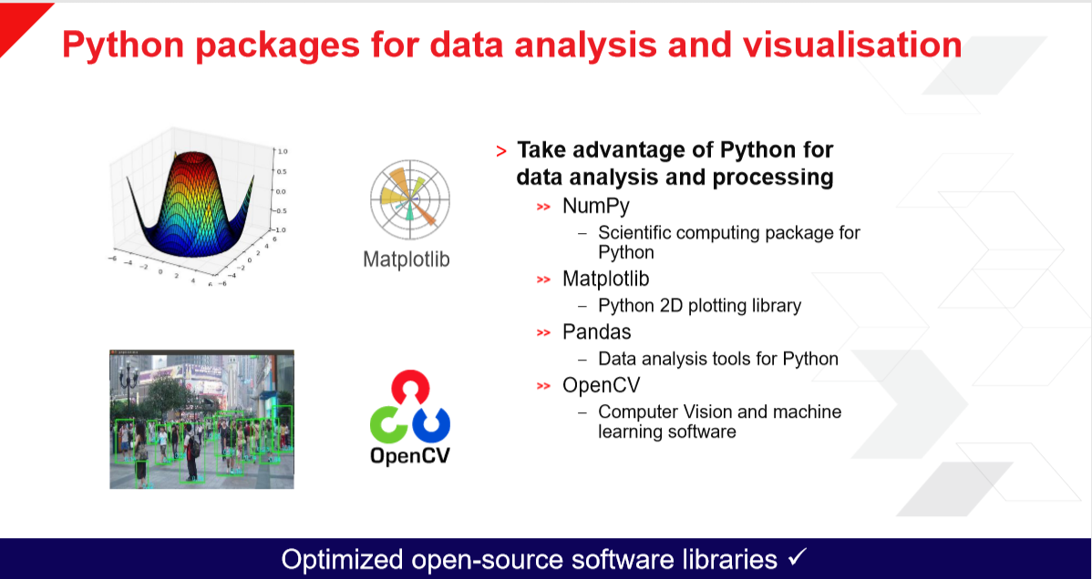

Slide 3
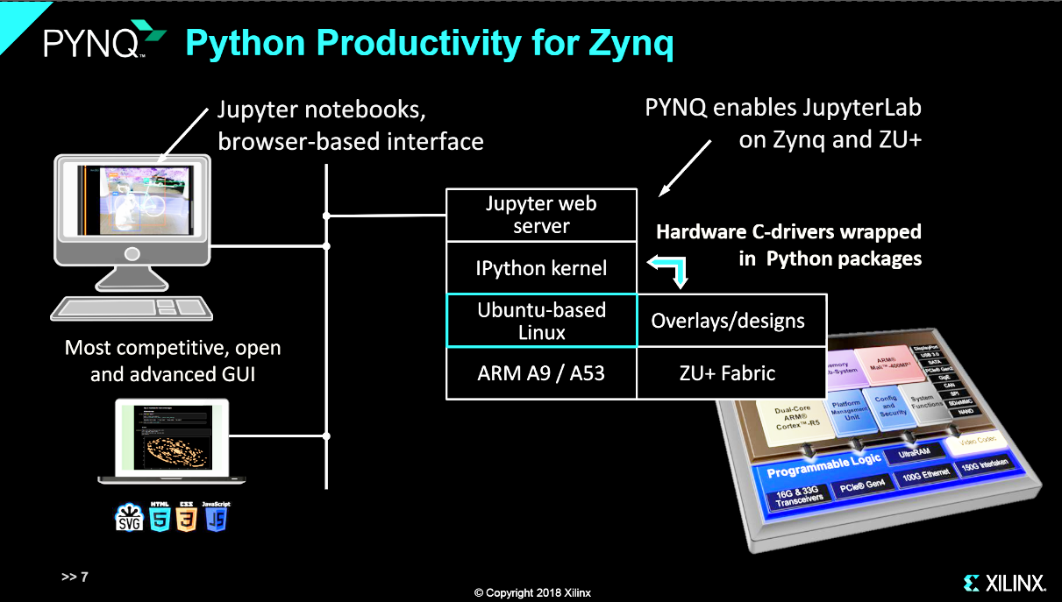

Slide 4
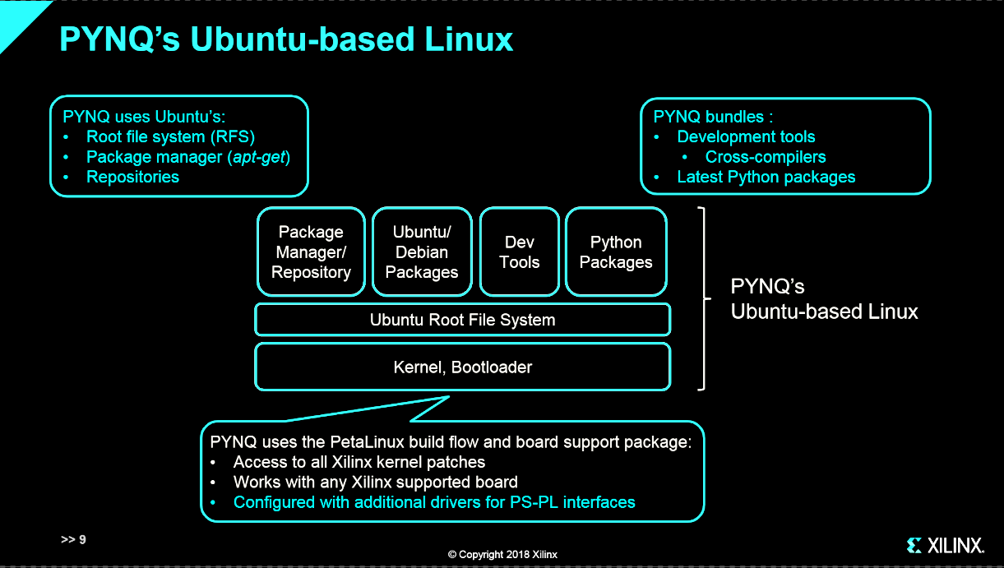

Slide 5
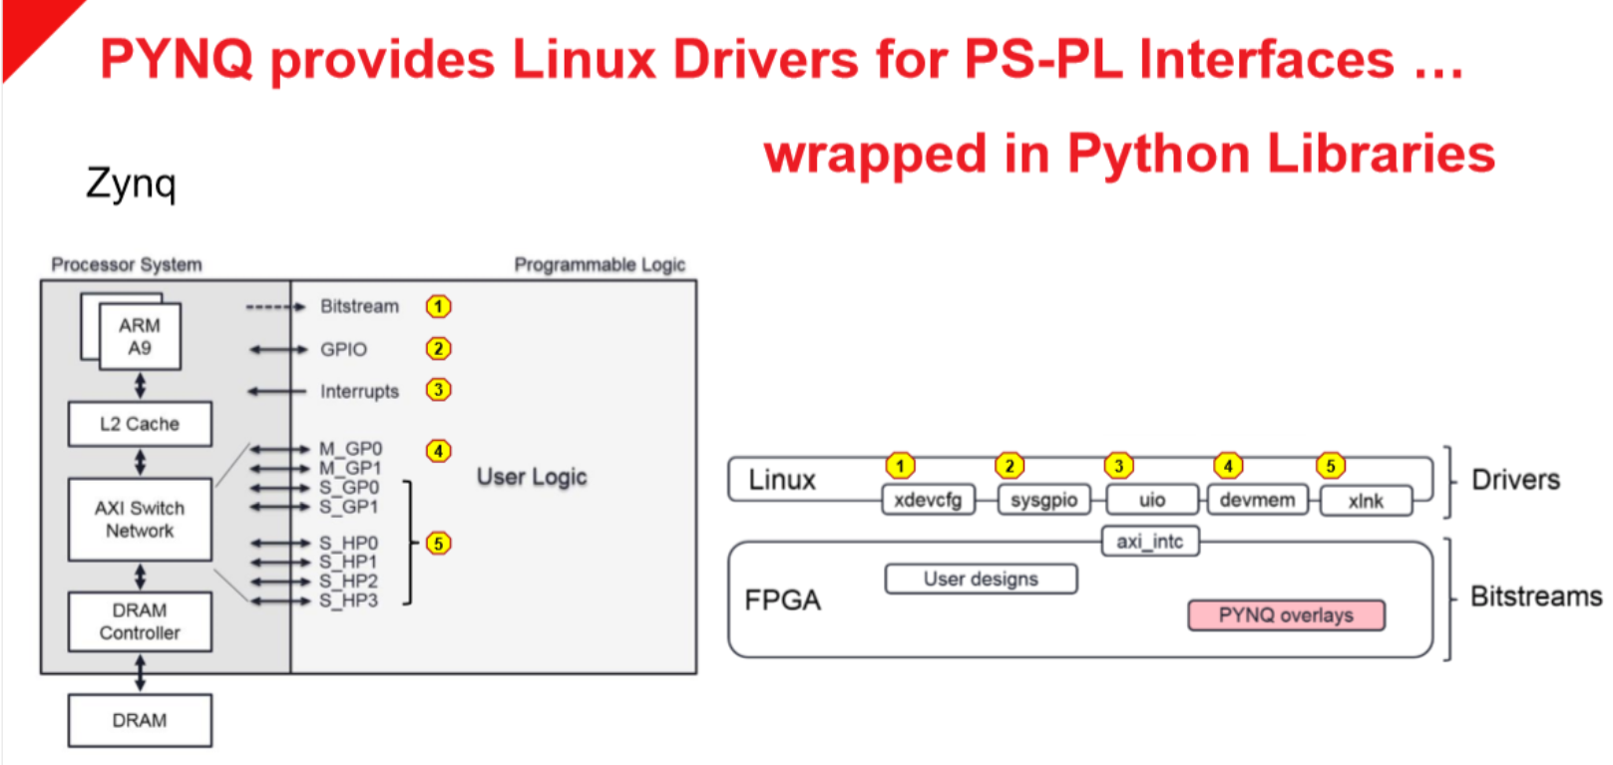
devmem: memory access
xlnk: memory allocate

Slide 6
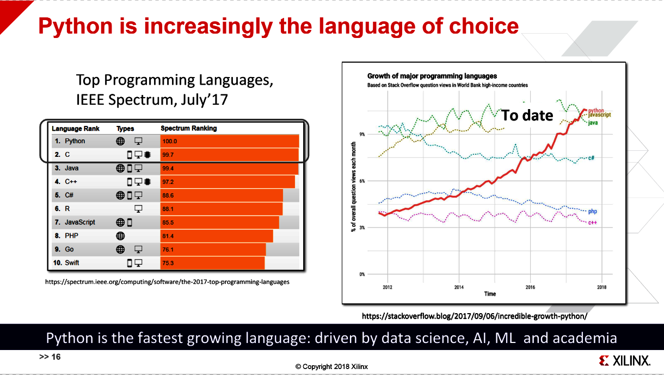

Slide 7


Slide 8
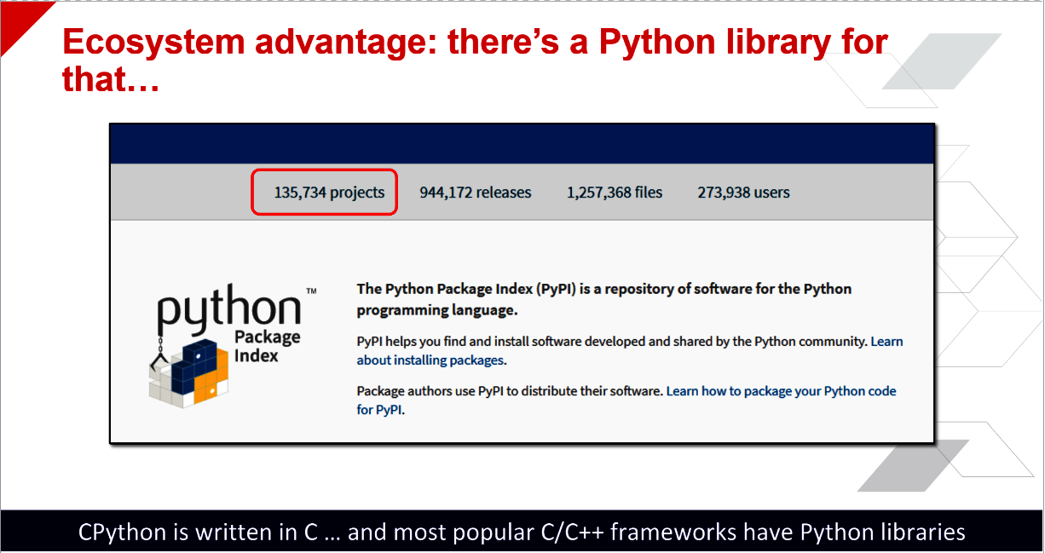
Cpython: python interpreter

Slide 9
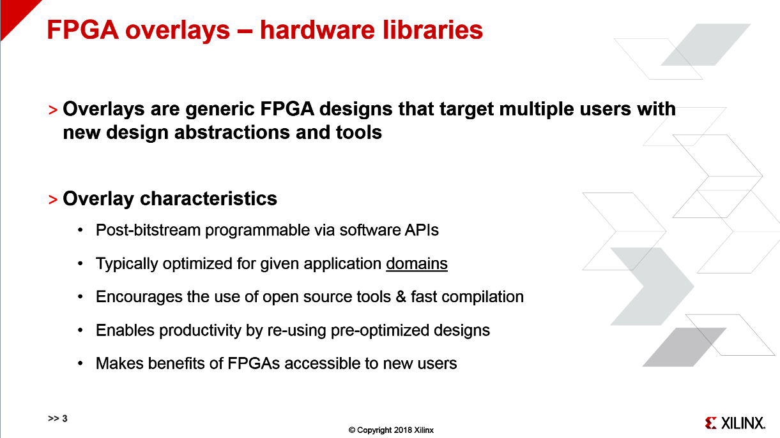

Slide 10
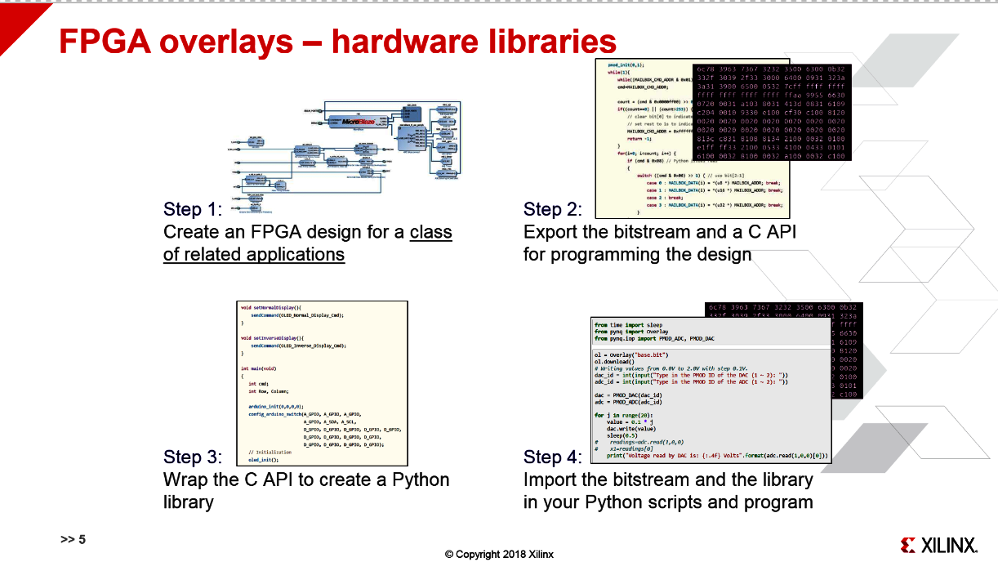

Slide 11
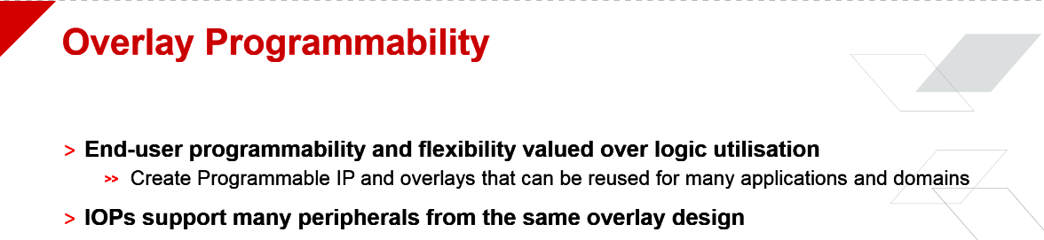

Slide 12
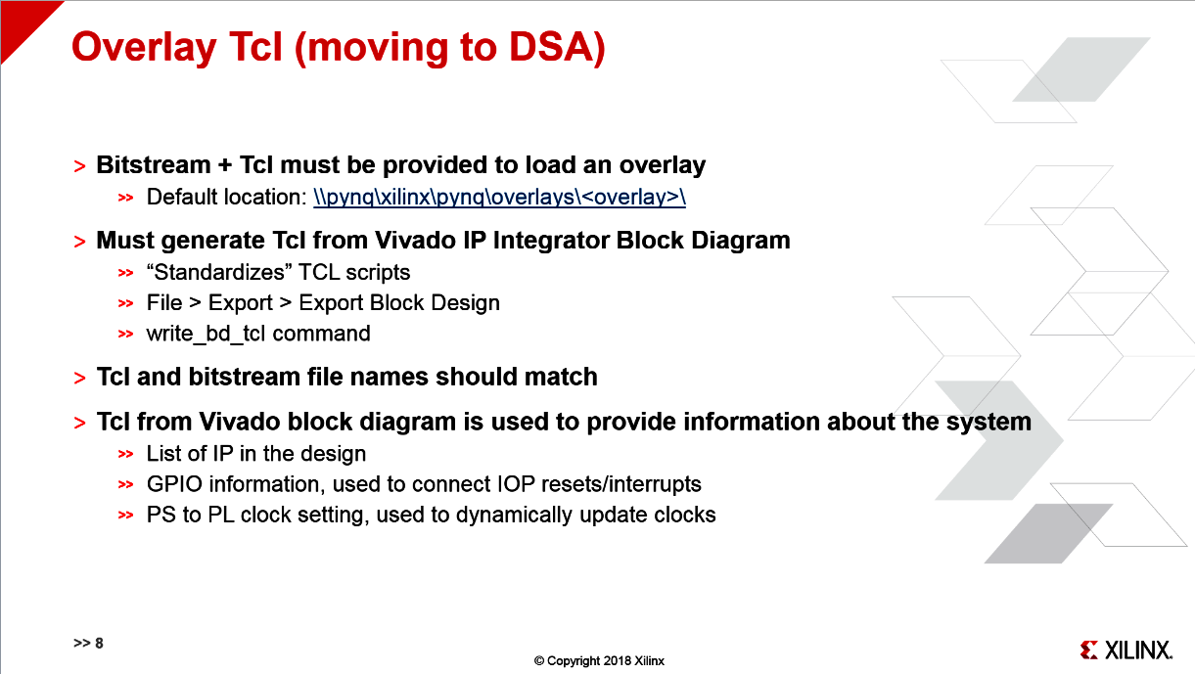
a Device Support Archive (DSA) which describes the hardware platform, a software platform, an accelerator board, and the SDAccel OpenCL runtime.

Slide 13
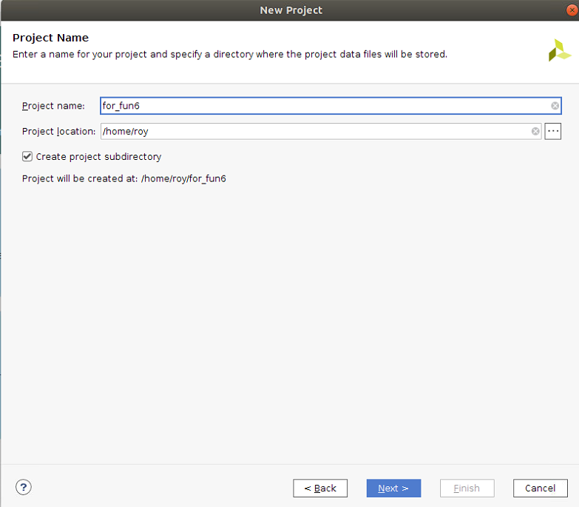
Create overlay
open vivado 2019.1->create project

Slide 14
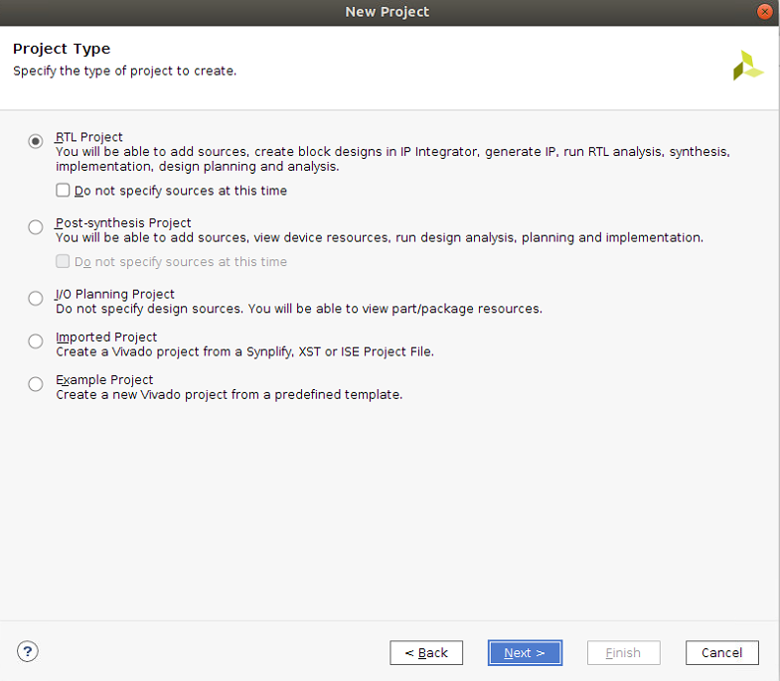

Slide 15
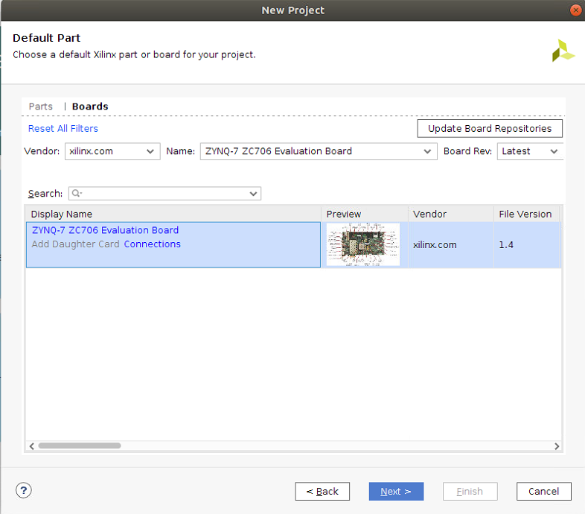
Choose board type

Slide 16
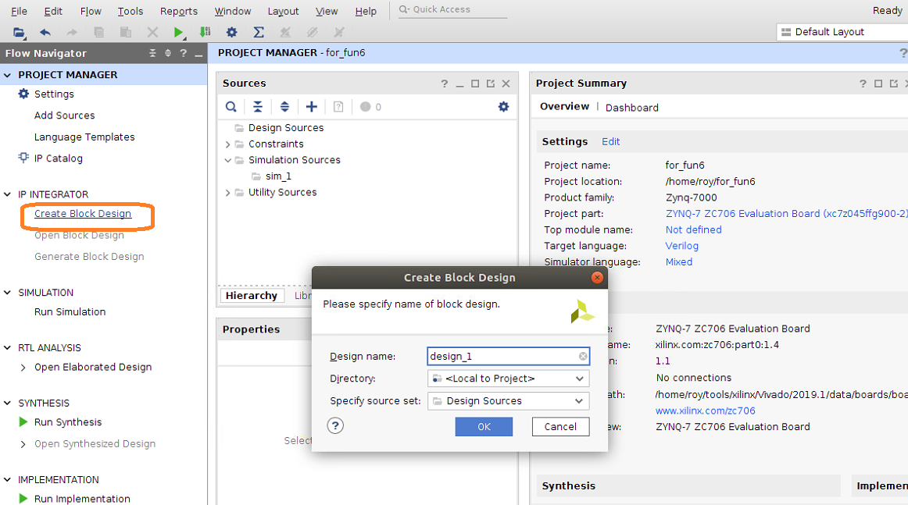
Create block design

Slide 17
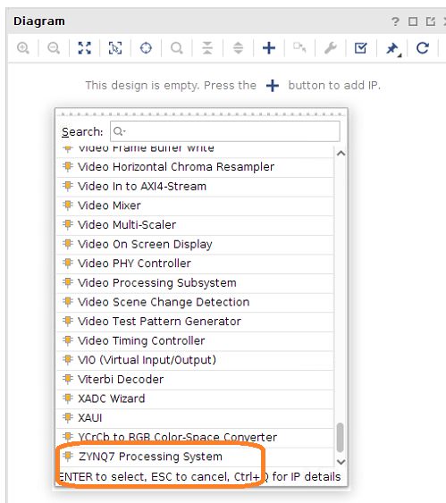
Add ip: zynq7 processing syatem

Slide 18
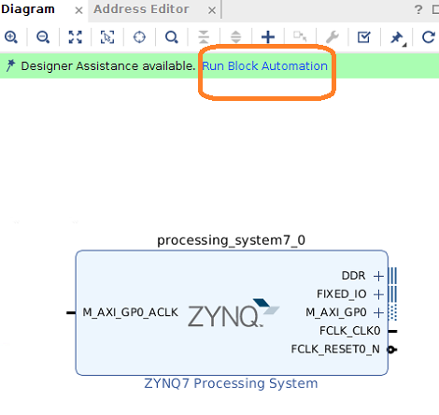
Run block automation

Slide 19
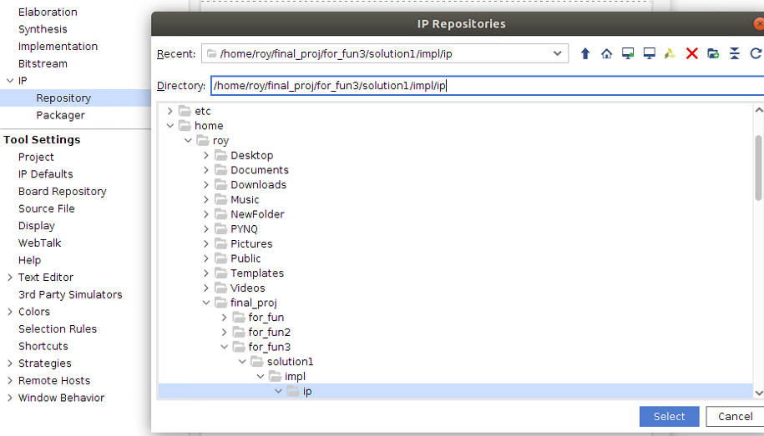
Add designed ip

Slide 20
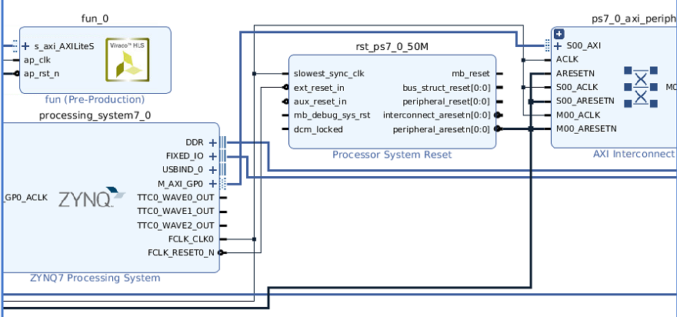

Slide 21
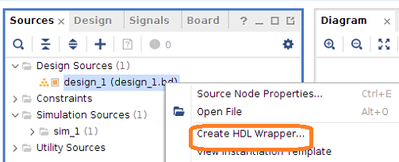
Create HDL wrapper

Slide 22
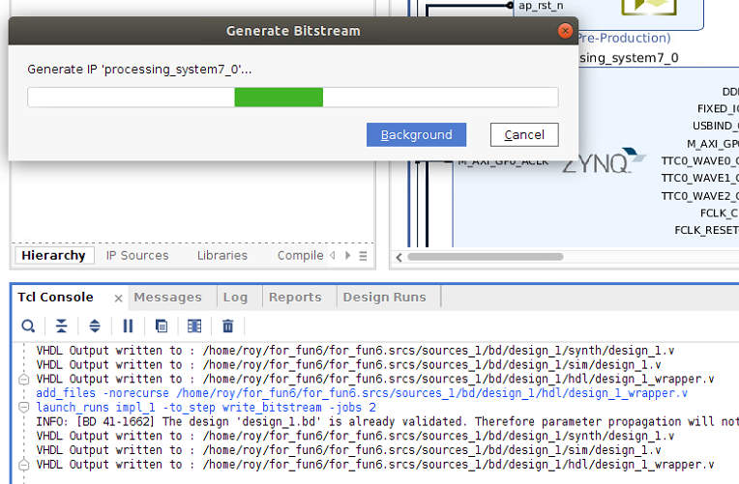
Generate bitstream

Slide 23
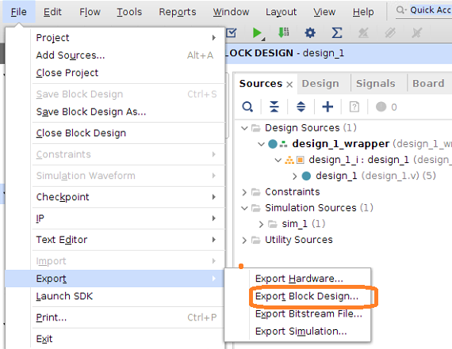
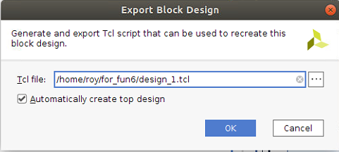
Generate tcl file

Slide 24
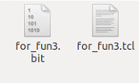
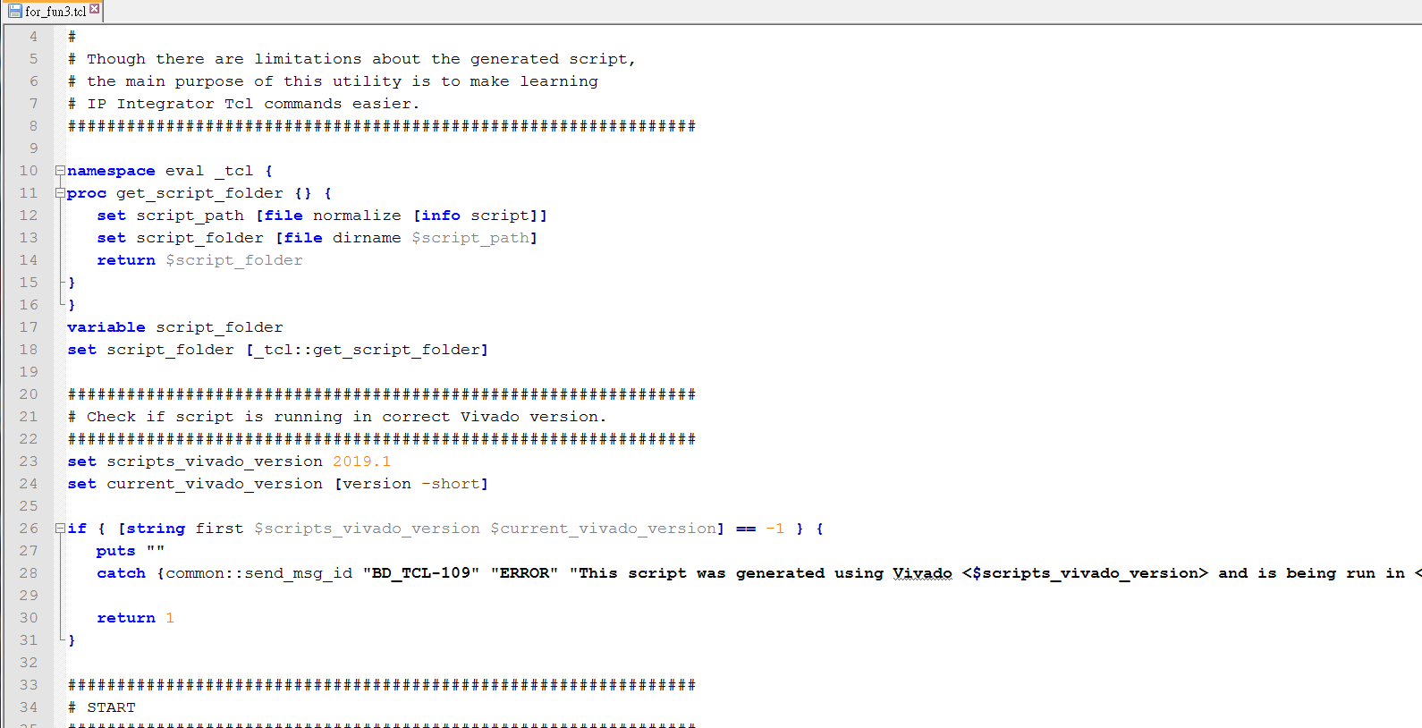
Dump
Set tlc & bit the same name

Slide 25
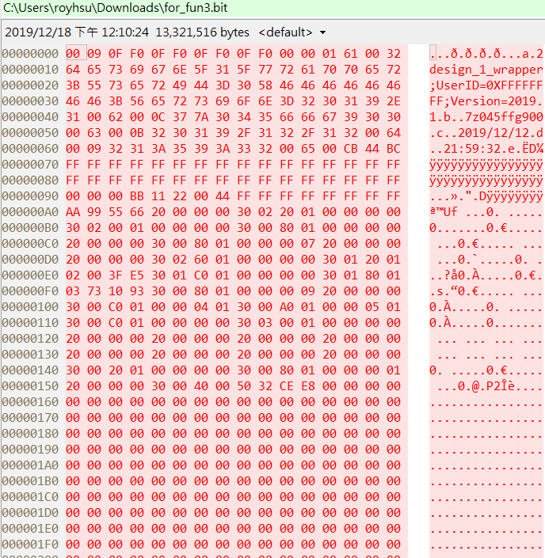

Slide 26
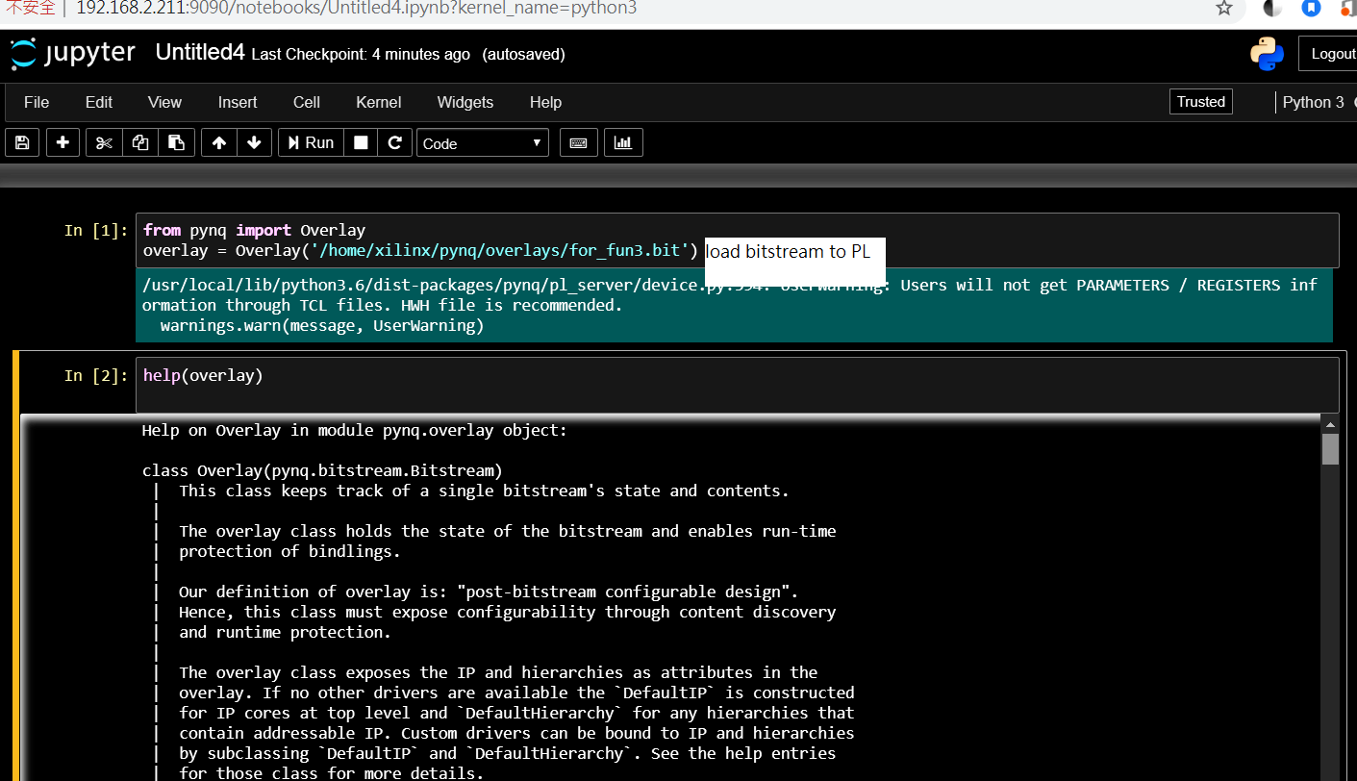
test
Copy tcl & bitstream to board

Slide 27
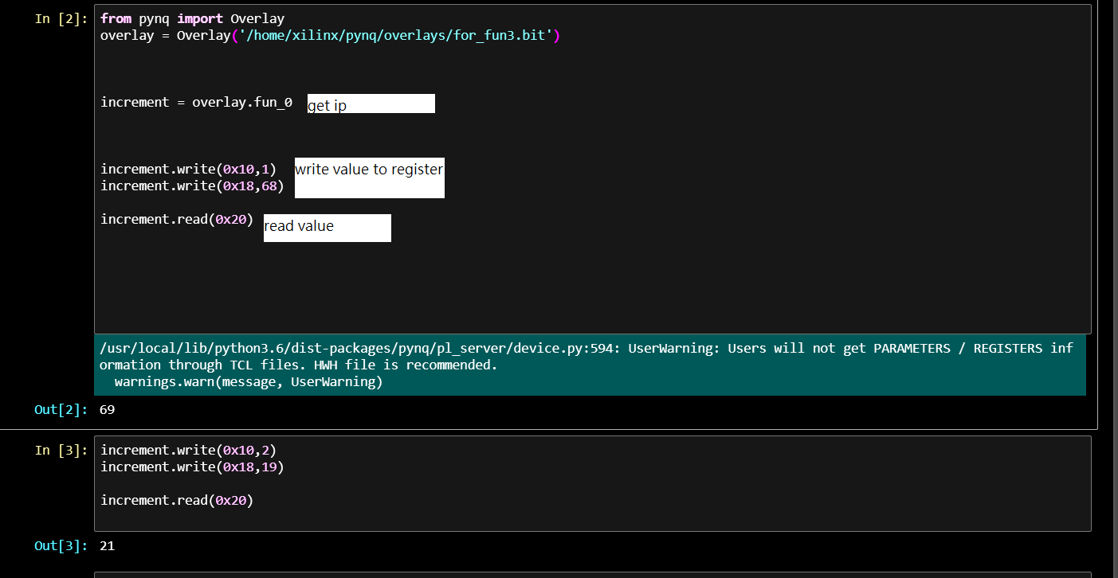
Ex1: download one bitstream

Slide 28
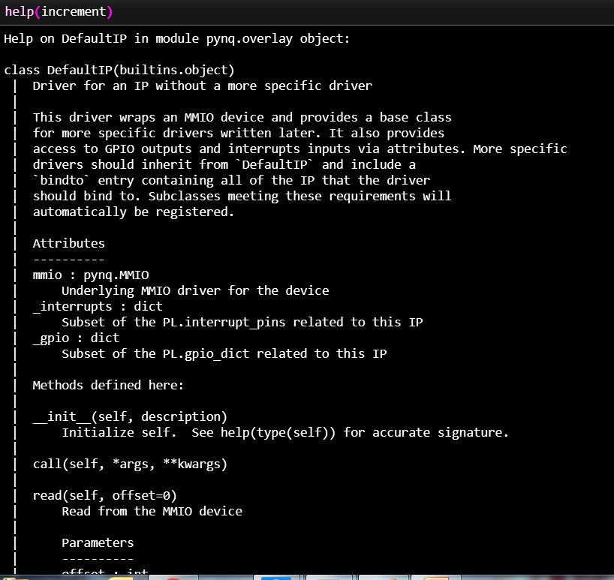

Slide 29
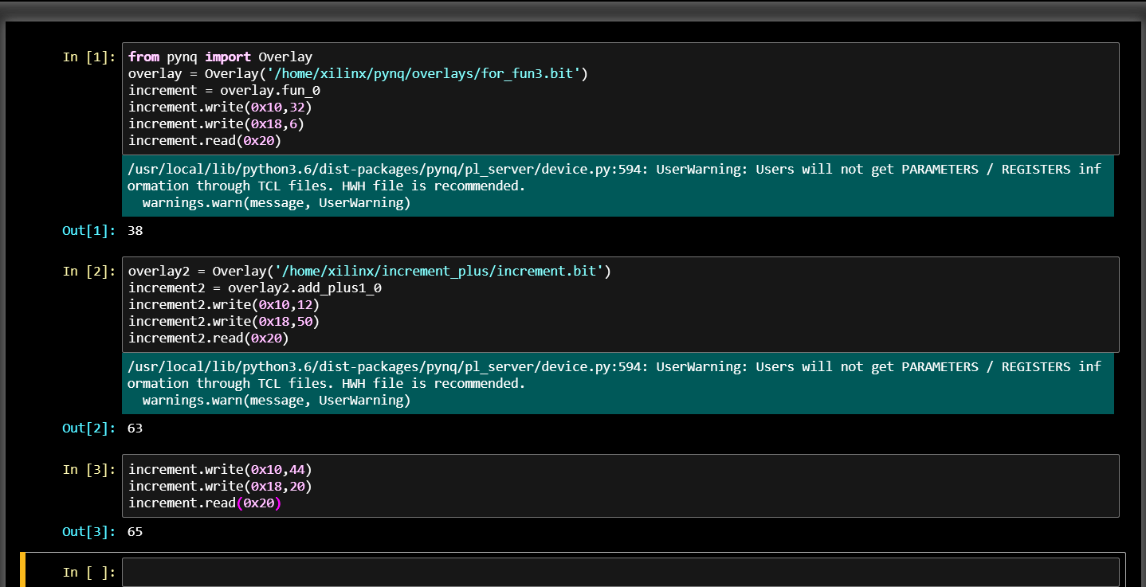
EX2:download two bitstream

Slide 30
reference
1. https://github.com/Xilinx/PYNQ_Workshop
2. https://pynq.readthedocs.io/en/v2.5/pynq_overlays/loading_an_overlay.html
3. ug994-vivado-ip-subsystems .pdf
4.

